Slide 1

Workload: Who am I?
An identity framework inspired by
the production infrastructure of Google
Team PaaSteurizers:
Emmanuel Mayssat – DevOps Staff Engineer – One Identity
Ravi Velineni – Senior Engineer – Cloud Engineering / Compute and Storage
Chella Thalaimuthu – Product Manager – Cloud Engineering
Alicia Robinson – Technical Writer – Cloud Engineering
Notes:
Workload: Who am I?
---

Slide 2
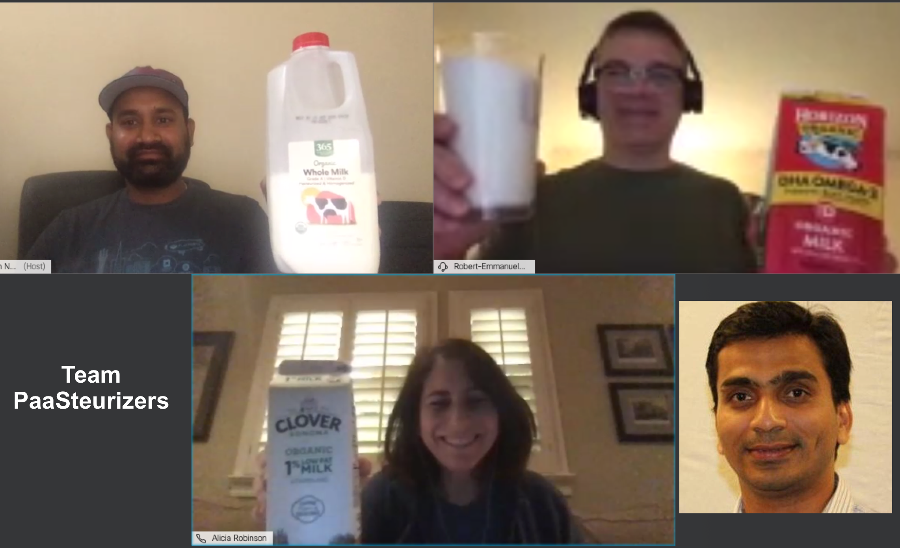
PaaS
Notes:
On Sept 9, 2020, 4 strangers came together to realize they had more than one thing in common
First they all loved milk
second they all strived to accelerate the adoption of PaaS
They call themselves… WE call ourselves “the PaaS-teurizers”

Slide 3
Workload identities at AMEX
Notes:
As a team, we quickly decided to explore issues related to identity management … in particular workload identities
So immediately, we scheduled calls/meetings with people in the IAM group and network security
Such as Jason Simmons, Andrew Zammit, Abhijeet Gandharwar to just name a few
---
Other people we would want to talk Phani Piduri, Kevin Kassner
The problem we decided to look is related to identity
But not to user identity, or authorization policy…. Which we believed have in lage part been solved
But workload identities… and I nparticular workload identities
We reached out to a few more people whom unfortunately we have had the time to talk to yet
But the

Slide 4
Results of our interviews
A workload identity service that works with all types of compute resources
virtual machines, Kubernetes,
pods, functions, or single processes
A workload identity service that supports heterogeneous environments
on-prem, public cloud, and hybrid could
Vmware, Openstack, GCP, AWS, azure
An identity platform that is open-source to avoid vendor lock-ins
A single identity service that is agile … and can be used by everyone
Notes:
What we discovered there is a need for a new, more modern, more agile workload identity service.
It needs to
work with all types compute resources , …such as pods/functions/processes
support heterogeneous environments, …. on-prem, public clouds, hybrid-clouds
Be open source to avoid vendor lock-ins
And my personal favorite,
what I would really really like to see, is
a single identity framework that can be used by everyone
to prevent vendor lock-ins
Ready for the future
1 team instead of many
Possibly 1 framework that be delegated/(~ DNS subdomain), federated

Slide 5
The Secret-Zero problem
I have talked to a number of security-conscious professionals across a wide range of professions. Their backgrounds and job functions vary, but they all have a common question, "what if someone hacks __." There is usually a good answer to this question that details how __ is protected by the security solution, but this line of questioning usually continues for a few more iterations until we arrive at a scenario that few security products have an answer for. The "what if someone hacks __" questions usually stop when we arrive at the ultimate secret that protects all other credentials; this is secret zero. What if someone hacks secret zero? The answer is: you are owned!
Organizations struggle to securely authenticate client requests for services and to securely distribute secrets without introducing more credentials that need to be guarded. Typically, secrets management solutions rely on a master key or secret zero that can unlock other credentials, allowing an attacker to move laterally and eventually own everything in the organization. Secret zero is an irresistible target for attackers, so it is typically stored in a Hardware Security Module (HSM), which itself requires credentials to access it, and those credentials must be stored securely too. So, you get the idea. This scenario is often compared to Russian nesting dolls, where opening one doll reveals many more. Securing secrets with secrets only give the illusion of security as one vulnerability in exchange for a different one.
Source: https://dzone.com/articles/dont-get-pwned-by-secret-zero
Notes:
In general, when we deal with identities,
you have to address the secret-zero problem
How can you give an identity to something…
you do not yet known,
you have never seen?
---

Slide 6
Google’s our approach to Secret-Zero: workload profiling / fingerprinting
The approach is so universal, it works with people too!
Ex: 20 years ago, Emmanuel picking his Indian mother-in-law 20 years ago at the airport whom he had never seen
Can an identity service profile workloads?
a long-running process running in a VMware VM, such as on TIMS?
an ephemeral function running in a PaaS, such as one-data?
a pod running in a Kubernetes cluster, as would be the case on eCP?
Our identity service gives identities based on profilers, aka attestors
An identity takes the form of a x509 certificate, a JWT, or both
As IAM administrators, we can re-use already-existing attestors or develop new ones.
Profiles can be as tight, as secure as desired
It is based on an open-source framework, called SPIFFE, which inspired by what is used at Google
Notes:
Our approach to secret-zero is to use profiling, workload profiling
To illustrate, let me use an analogy
20 years, I was tasked to pick up my mother-in-law at the airport,
Unfortunately my wife could not go… my wife could not come
And (my mother in law) I have never seen her
How could I pick the right person?
This is what I did:
I went to the airport she was scheduled to arrive to
Went there at the right time
(still hundreds of strangers were streaming through the gates)
But I knew she was a woman… Indian…
I knew her approximate age range… and that she was by herself.
I also knew… she would respond to the first name “Chitra”
That’s how I found “Chitra”… and when I got home, …god blessed … my wife confirmed I had picked the right person!
Now can an identity service also profile workloads?
A process, a function, a VM, a pod?
On VMware, AWS, or GCP
Our identity service gives identities … certificate, JWT token … based on ‘profiles’
---
Paranoid..
What is an attestation mechanism? = method used for confirming a device/workload’s identity
The profiling/fingerprinting can be as loose or as tight as desired.
Ex: I will give a certificate/JWT/and ideitnty to any process that runs in
a ‘loyalty’ Vmware VM machine that belongs to ‘Loyalty’ group
That VM needs to run in our IPC2 datacenter, in the R2 availability zone,
the process needs to be running as the ‘apache’ user
the binary the process is running needs to be located at a given path and have a given sha
And on and on… until you are satisfied

Slide 7
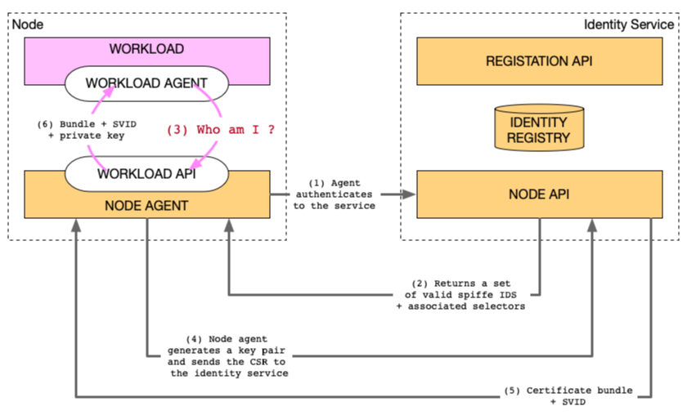
Architectural Diagram
Notes:
This is the architectural diagram,
On the right hand side… our HIGH-AVAILABILITY … identity service
Let’s assume it is already deployed,
Now imagine a new node… (seen on the left) … a VM… just appears or autoscales
As soon as the VM starts booting… the node agent … possibly burned in the image … contact the identity service
THe first 2 steps… is the profiling of the node agent,
The node agent is an identity service component.
Once booted and from then on,
any workload deployed on that node can query… the node agent
Be profiled
And get an identity.
This is represented with step 3 to 6
---
Autoscaling
(2 steps) Node agent comes up and is profiled before joining the ‘existing’ trust network
Any workload that gets started on this node can connect with the agent to be PROFILED to get an identity
As depicted above, from the application perspective that’s a 4 step process
Node:
Deployed on Vmware infrastructure, EX: TIMS
Identity service = more than 1 component
HA of server + identity registry
Agent/node attestation
(one-time token, … ) = Node Attestation. → grow the trust network → workloads on that node can get an identity
Workload attestation
Workload can request an identity in 2 form factors (1) JWT / AWT (2) certificate <!> Both can be issued and used at the same time!

Slide 8
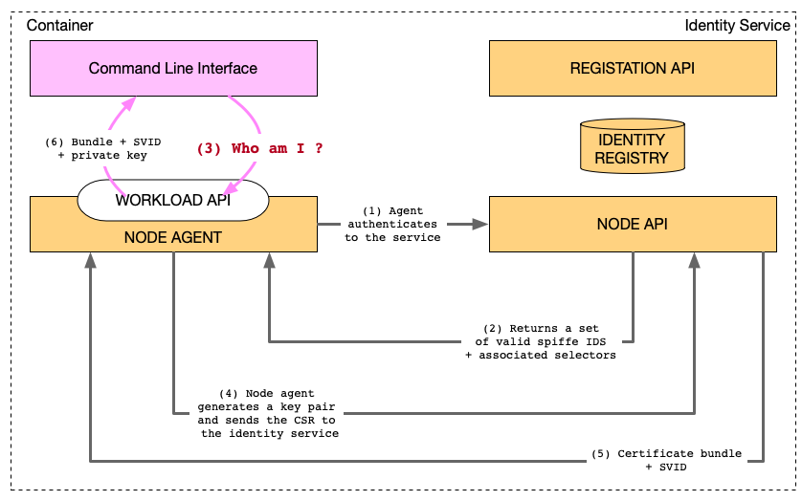
Identity service components + Workload profiling = Getting an identity from the CLI
Demo 1
Repo: https://stash.aexp.com/stash/users/rmayssat/repos/oneamex-200910-growthhack-1-components/browse
Instructions: https://stash.aexp.com/stash/users/rmayssat/repos/oneamex-200910-growthhack-1-components/browse/README.md
Notes:
If you are interested to understand how all the identity service components and the workload interact, I invite you to go through our 1st demo
---

Slide 9
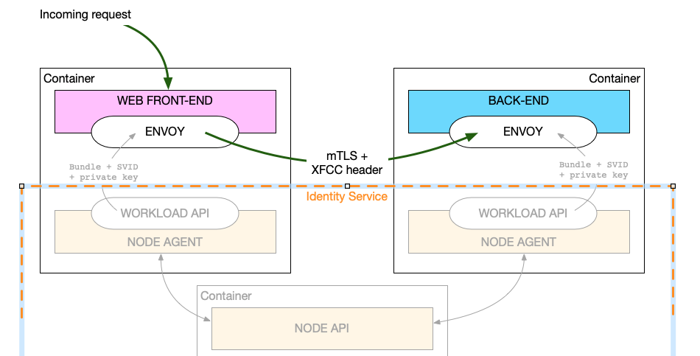
No application code change required! (Thanks to envoy’s SDS API, it is now part of the platform)
Demo 2
Repo: https://stash.aexp.com/stash/users/rmayssat/repos/oneamex-200910-growthhack-2-envoy/browse
Instructions: https://stash.aexp.com/stash/users/rmayssat/repos/oneamex-200910-growthhack-2-envoy/browse/README.md
Notes:
The purpose of our second demo is different.
Here want to show is that to start using our identities, no code change …in the application… is required.
Indeed, thanks to the SDS API of envoy proxies, identities can be managed by the PaaS, the platform
---
What is SDS
- gRPC between Agent/workload API and Envoy ➔ certificates are pushed to the proxy before they expire!
mTLS -> zero trust network
Different from Kubernetes sidecar injection
Proxy is a stand alone process running on the machine

Slide 10
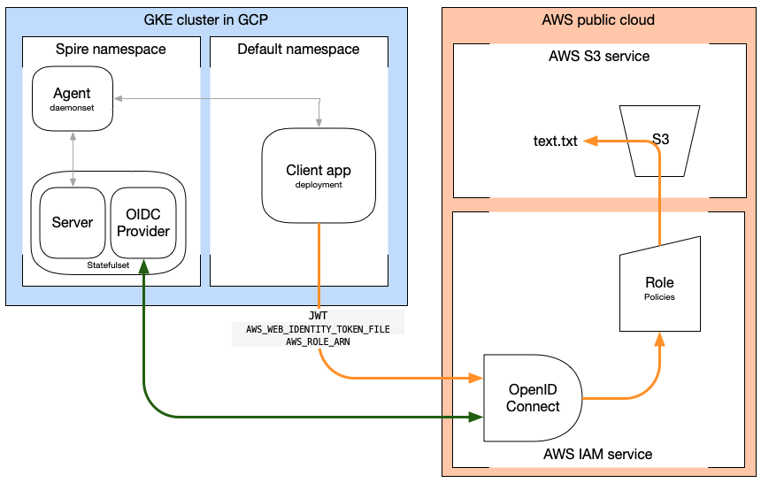
Identities that span cloud platforms: GKE to AWS S3 (Truly supports heterogenous environments)
Demo3
Repo: https://stash.aexp.com/stash/users/rmayssat/repos/oneamex-200910-growthhack-3-oidc/browse
Instructions: https://stash.aexp.com/stash/users/rmayssat/repos/oneamex-200910-growthhack-3-oidc/browse/README.md
Notes:
In that 3rd and last demo, we show our SPIFFE identities work in a heterogenous environment.
In particular, we show how a workload,
a pod deployed in GKE
can securely access a private bucket in Amazon S3
---

Slide 11
Summary
Through interviews, we unearthed the need for a new kind of workload identity service
Needs to work with all compute resources
Needs to work in heterogenous environments
Needs to be open source
Through this hackathon, we have demonstrated that our identity framework is a match
Works with containers, pods, VMs, single processes
Same identity in a heterogeneous environment
No application code change is required
We can get started started immediately … with existing applications!
SPIFFE is being evaluated, maybe already used by Square, Uber, Bloomberg, Github, Anthem, Pinterest
As a leader of this team, I am willing to undertake the effort
Notes:
To conclude, we have interviewed colleagues and identified a need for a new, modern, agile workload identity framework.
Through this hackathon, we have demonstrated that our identity framework is.. a match
It is open source… works with containers/pods/VMs …. supports in heterogeneous environments
BEST of all to continue and build a MVP … no application code change is required.
WE can get started immediately!
Indeed, SPIFFE is already being evaluated at other companies
In fact, as a PaaSteurizer …. and a strong believer of SPIFFE, … at AMEX … I would love to take the lead
----
Maybe what we are missing is a leader to undertake this effort
… and understand SPIFFE’s true potential …
To be honest as the leader of this team… I know someone would can just do that

Slide 12

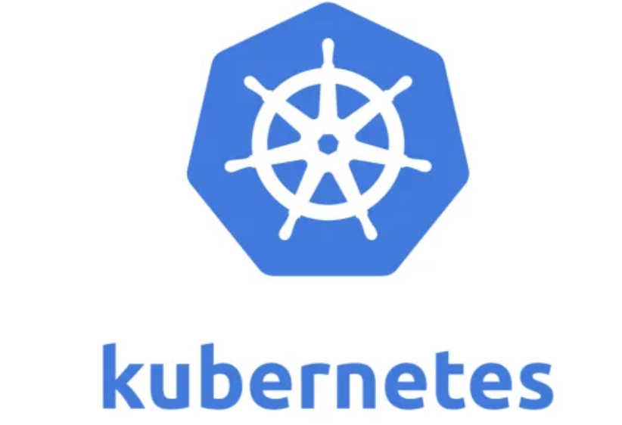

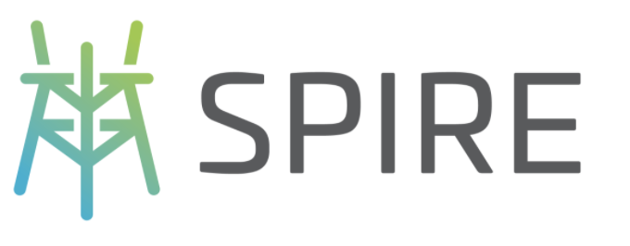




PaaSteurizers’ tech stack

